Slide 1

Welcome to our Virtual Back to School Meeting
Cleveland Metro Remote School
We will begin shortly.
Please mute your microphone.

Slide 2
CMSD Vision
In our pursuit of a more fair, just and good system of education, we want each of our learners, both each of our scholars and each of their educators, to be individually and collectively presented with academically/intellectually complex tasks that are worthy of their productive struggle and allow them authentic opportunities to demonstrate their work and their learning of academic content and transferable skills in a joyful and adventurous environment.

Slide 3
Welcome
Please mute your microphones.
The meeting is being recorded for families who cannot attend, and a copy of this recording will be placed on our website.
If you have questions during the presentation, please place them in the chat.
We will have a question/answer session at the end of the presentation.
If you are calling in, please email joseph.Ciesielski@clevelandmetroschools.org, and we will respond within 48 hours.

Slide 4
Our Priorities
Maintaining the health, safety, and well-being of our scholars and staff
Exemplify excellence in learning and teaching, filled with joy and aligned to a coherent, unified core curriculum
Supporting our scholars, staff, and families as they adapt to new methods and rhythms of learning and teaching
Ensuring operational efficiency across the organization to encourage flexibility and financial health
Partnering with community organizations and leveraging local assets to more fully and equitably support our scholars and their families
and well-being of our s

Slide 5
We are in this together
We are committed to maintaining the health, safety and well-being of our students, families and educators.
We will support our scholars, families and educators as we adapt to new methods and cycles of learning and teaching
We will provide regular communication about your scholar’s progress.
We will partner with community organizations to support our scholars and families.
We are all learning to navigate this new “normal” and will continue to partner with you throughout the year.

Slide 6
Important Contacts
Principal: Joseph Ciesielski
(216) 838-7052
Joseph.Ciesielski@clevelandmetroschols.org
Texting: (440) 373-7955
Assistant Principal: Craig Kiston (K-8 support)
Craig.Kitson@clevelandmetroschools.org
Secretary: Denise Dorney
(216) 838-7052

Slide 7
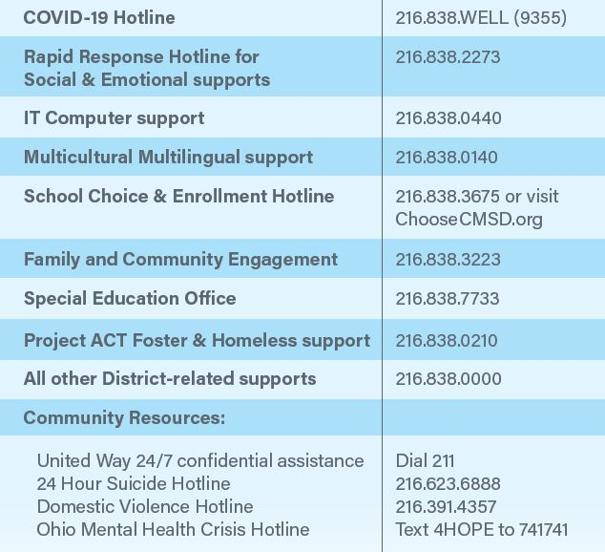
Other Important Numbers

Slide 8
School Office Hours and Visitation Procedures
School office hours: 8:00 a.m. to Noon and
1:00 to 2:30 p.m.
Please call to make an appointment prior to visit.
Visitors will complete COVID-19 health screening and have their temperature checked prior to entering the building. Visitors should social distance (6 feet).
All visitors must wear a face mask. If you don’t have a mask, one will be provided.

Slide 9
Technology Distribution

Slide 10
School Supplies and other resources
CMSD has purchased remote learning kits which will include school supplies and ear buds for your scholar to use for remote learning
You will be contacted when these items are available to pick up from our school

Slide 11
Schoology – Remote Learning Platform
Schoology is an integrated learning management solution which provides course management, mobile learning, and support for communication.
Schoology enables our scholars, parents and teachers to engage with learning materials and their school community from the classroom and beyond.
With Schoology, scholars can digitally submit homework assignments, review grades, participate in interactive discussions, receive announcements and feedback, take tests, write academic blogs, and more.
As a parent, you will be able to view your child’s activity and progress within the platform and communicate with teachers.

Slide 12
Schoology – Remote Learning Platform
Parents and students can access Schoology though the Clever Learning Portal.
Students can use their digital badge or username and password to login to the Clever Learning Portal
Schools can assist students with their Clever username and password.
Parents that do not have a Clever username and password will receive an email invitation sent to the email that you have on file at your child’s school. Your invitation email will include a brief tutorial and link to create a Clever account.
If you did not receive an email or received an invitation, but need help logging into Clever, email CMSD.Integration@ClevelandMetroSchools.org for assistance. Training and support resources will be available on CMSD’s public website regarding how to access and use Schoology and other learning applications

Slide 13

Standard Remote Learning School Day
  Standard K-12 student instructional day – 8:00 AM to 2:30 PM
    Students will have a formal class schedule
    Monday, Tuesday, Thursday, Friday: Synchronous learning (classes) for up to 150 minutes per day; asynchronous learning (homework) for 150 minutes per day
    Wednesday: Family engagement, Asynchronous learning, tutoring, office hours, small group instruction, etc.

Slide 14
Standard Remote Learning School Expectations for Success
Expectations | What does this look like?
Student present and engaged | Student attending both on-stage and off-stage time periods Students answering questions during class
Seek help when needed | Students will message teachers in chat or via Schoology Students will communicate in polite ways
Demonstrate learning with completion of assignments | - Students will complete guided and independent assignments both during and after class.
Be patient with yourself and your teachers | Students will allow for mistakes and push to improve Students will focus on what they can control

Slide 15
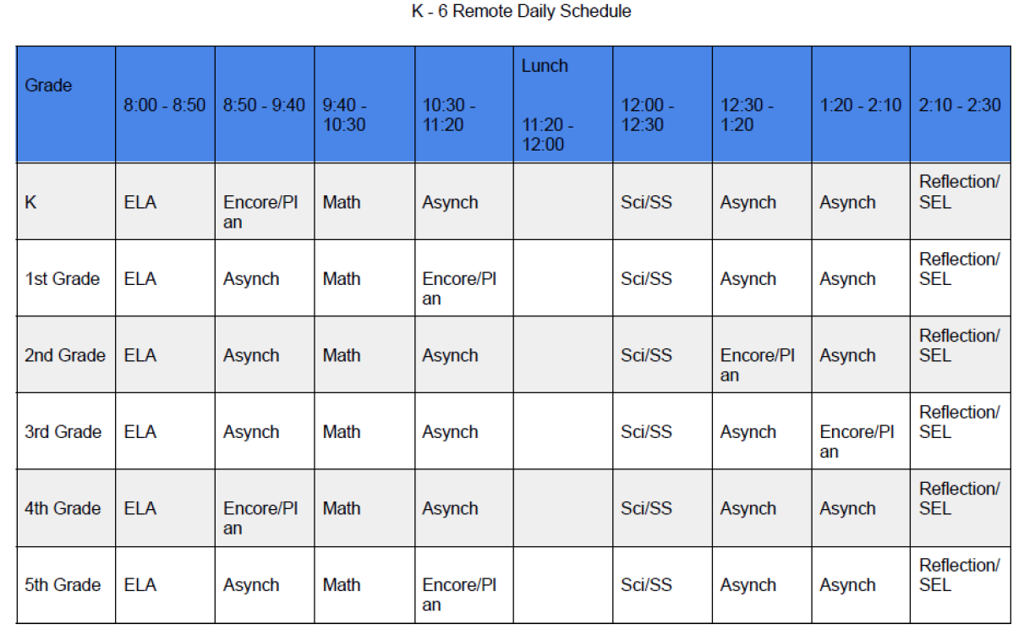
Standard Remote Learning School Schedule

Slide 16
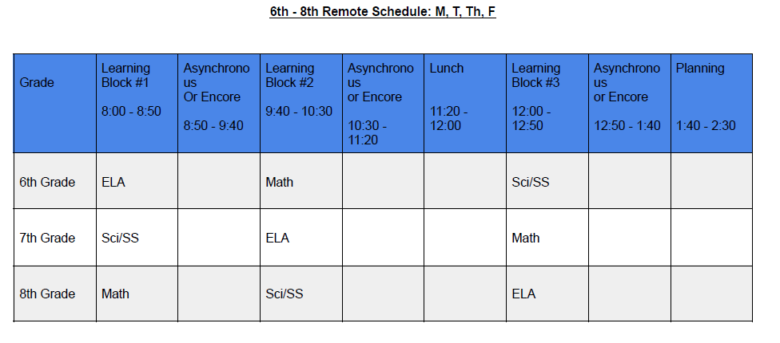
Standard Remote Learning School Schedule

Slide 17
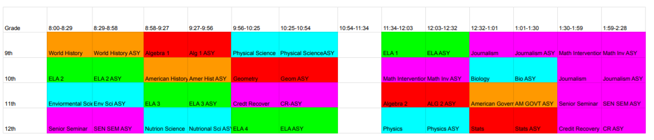
Standard Remote Learning School Schedule

Slide 18
Supporting your scholar’s remote learning
Get back into the routine of school, i.e. making bed, grooming, dressing for school, etc.
Scholars should wear school appropriate clothing during remote learning.
Create a schedule with your child and make a commitment to stick with it.
Structure and routine can greatly help your child from falling behind with assignments.
Discuss your family’s schedule and identify the best times for learning and instruction, as well as family-oriented physical activity, such as walks outside.
A family calendar or other visuals could be useful for keeping track of deadlines and assignments.

Slide 19
Daily schedule
Example K-8 family schedule | Example 9-12 family schedule
7:00-8:00 am -eat breakfast -ensure computer is charged or plugged in - setup materials in remote learning space 8:00- 11:20 am -Participant in on-stage classes -Complete work in off-stage time -Ask teacher's question 11:20 – 12:00 am - eat lunch - take mental break - check on siblings 12:00 – 2:30 -Participant in on-stage classes -Complete work in off-stage time -Ask teacher's question - Reflect on day After-school -Check daily activity - prepare meals for next day - prepare school materials and laptop for next day | 7:00-8:00 am -eat breakfast -ensure computer is charged or plugged in - setup materials in remote learning space 8:00- 10:50 am -Participant in on-stage classes -Complete work in off-stage time -Ask teacher's question 10:50 – 11:30 am - eat lunch - take mental break - check on siblings 11:30 – 2:30 -Participant in on-stage classes -Complete work in off-stage time -Ask teacher's question - Reflect on day After-school -Check daily activity - prepare meals for next day - prepare school materials and laptop for next day

Slide 20
Supporting your scholar’s remote learning at home
Find a space in your home that’s free of distractions, noise, and clutter for learning and doing homework.
This could be a quiet, well-lit place in your dining room or living room or a corner of your home that could fit a small table, if available.

Slide 21
Supporting your scholar’s social emotional wellness
Watch for behavior changes in your child (e.g., excessive crying or irritation, excessive worry or sadness, unhealthy eating or sleeping habits, difficulty concentrating), which may be signs of your child struggling with stress and anxiety.
Ask how your child is feeling and communicate that what they may be feeling is normal.
Identify opportunities for your child to be physically active during virtual/at-home learning.
Reach out to school staff for support.

Slide 22
Questions and Answers
Please place your questions or comments in the chat.
If you are participating by phone, please email your questions or comments to joseph.Ciesielski@clevelandmetroschools.org

Slide 23
Closing Comments

